Slide 1
VaccoBook Vaccines, Hospitals and everything 2020-21
DBMS Mini Project
Made by:-
Pooja Ganesh
Muskan Jain

Slide 2
Topics Included :-
Introduction
Front-end Tools
Back-end Tools
Flow Of the Website
Screenshots From Website
Conclusion

Slide 3
Introduction
In this pandemic, where citizens of india are not able to find proper facilities of Oxygen, transportation and Vaccination .We are here with our website named VaccoBook which provides you details of transportation, hospital ,oxygen and beds availability and one can also register oneself for COVID-19 vaccination at the nearest vaccination centers.

Slide 4
Frontend Tools
For website Designing:
HTML
CSS

Slide 5
Backend Tools
PHP Language
Xampp Server
MySQL in the Database
Apache Module

Slide 6
Flow Of The Website
The website has User And Admin Login methods.
For this when people enter their credentials, the details will be compared with the ones in the xampp server.
New Users can sign-up and are then redirected to the Login Page
Users can view a collection of hospitals and book hospitals according to vaccine availability.
After booking the user booking details will be stored in the server, which the admins can access to view.
Admins can login to add, remove, or view the data.

Slide 7
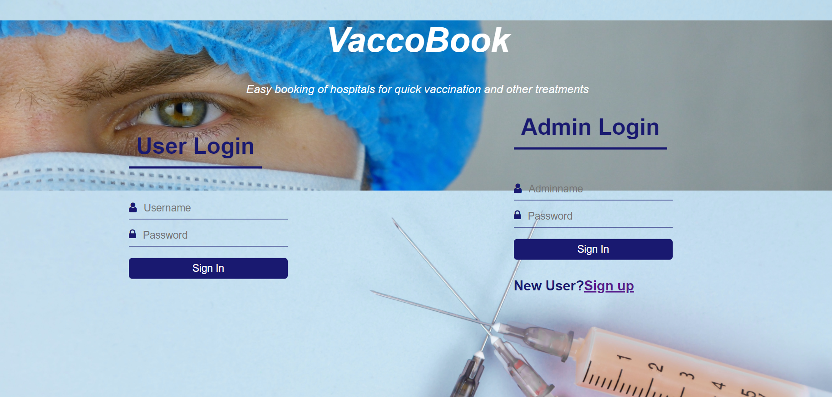
Demo Screenshots :-
Login And Sign-Up Page

Slide 8
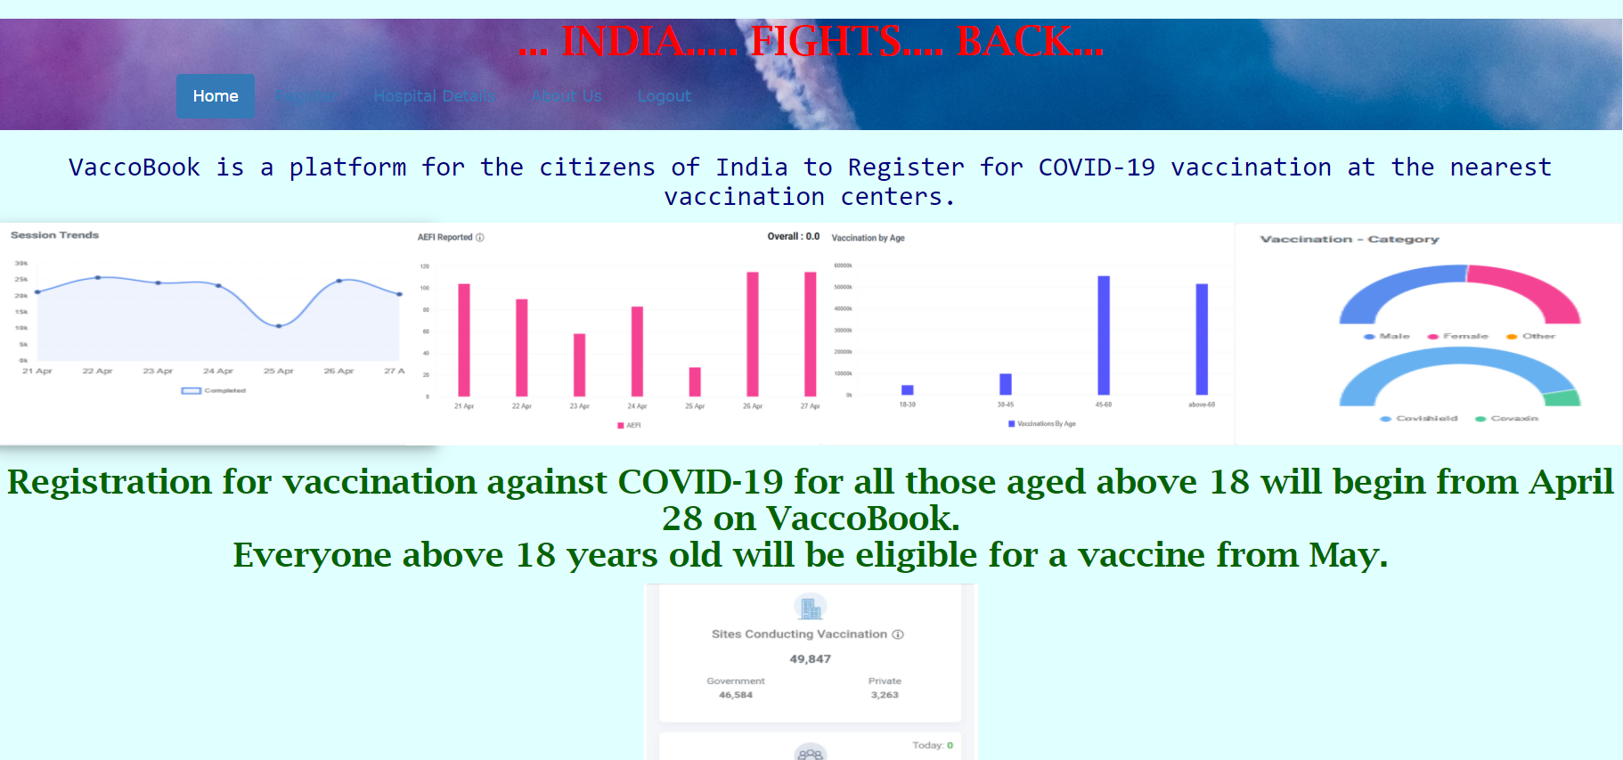
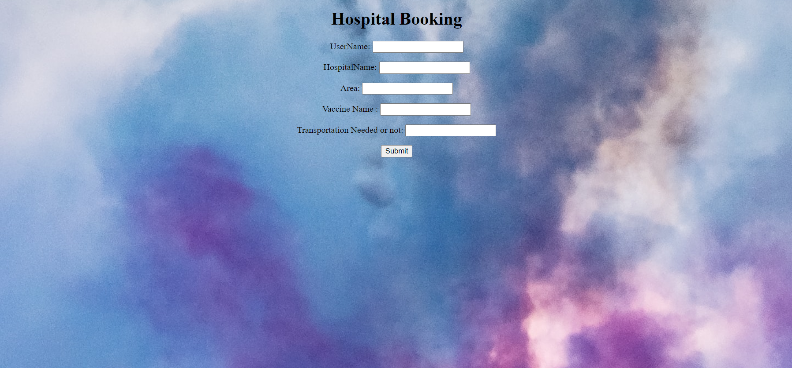
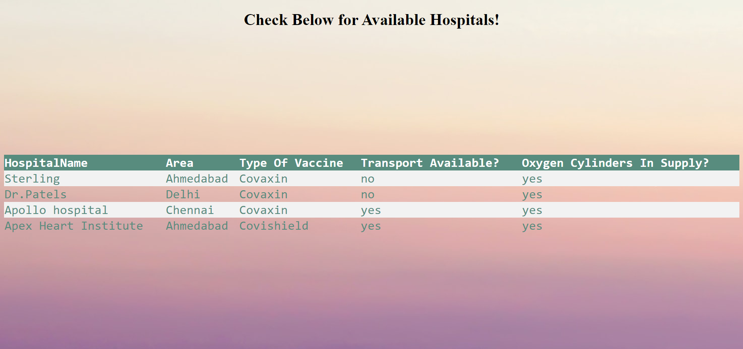
User Main Page - Register, Hospital Details

Slide 9
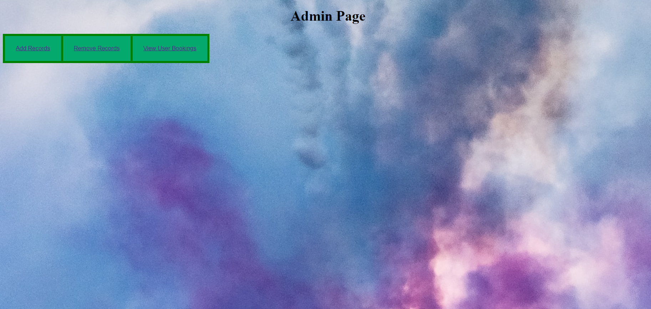
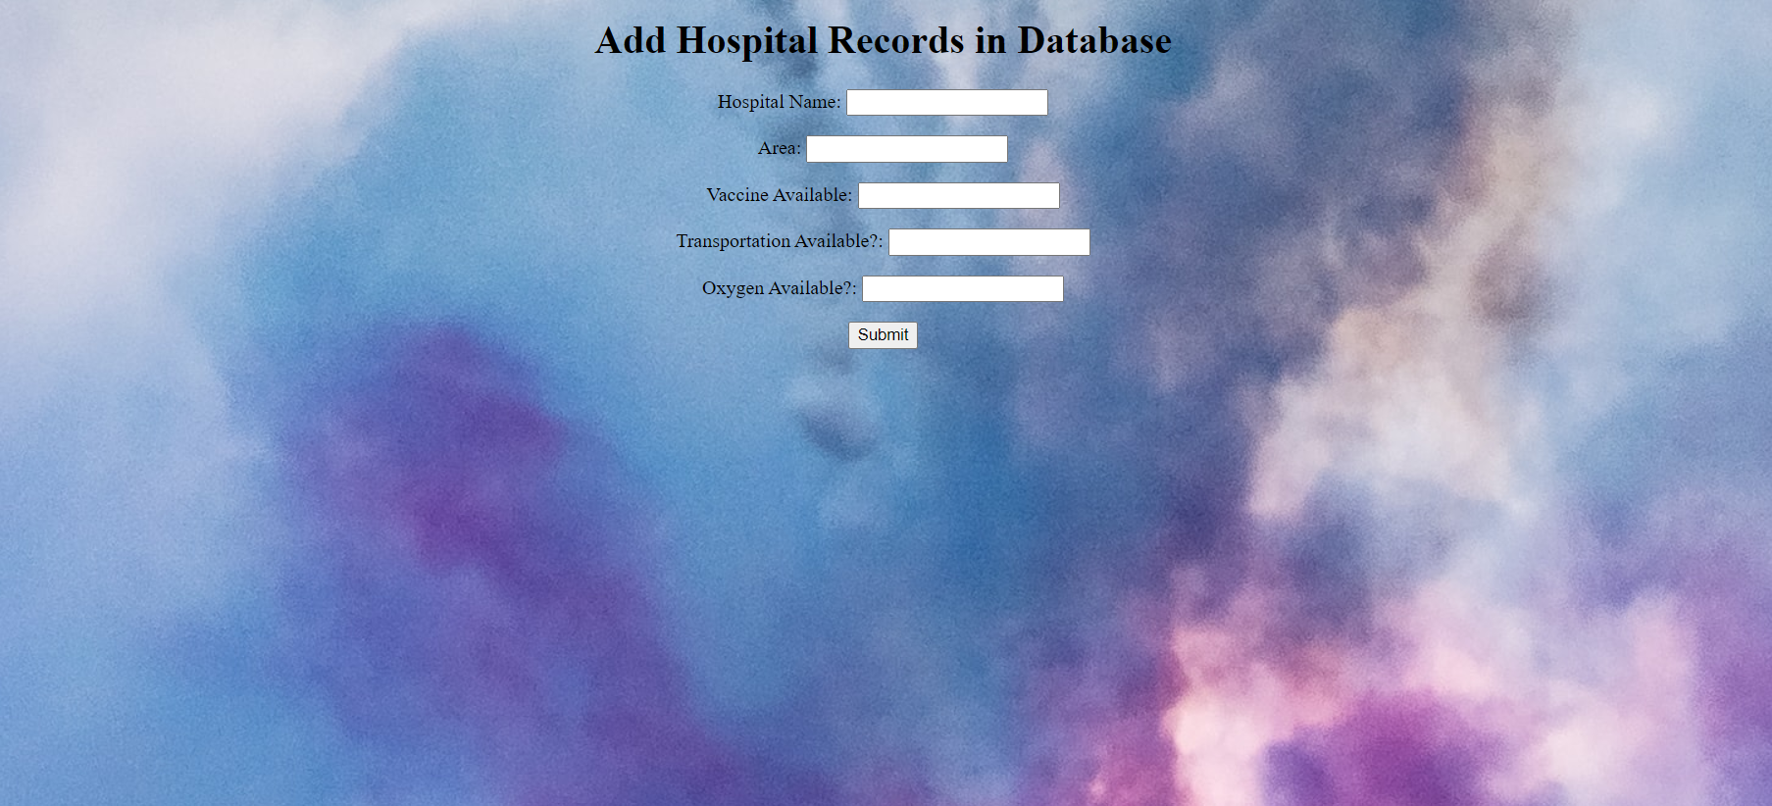
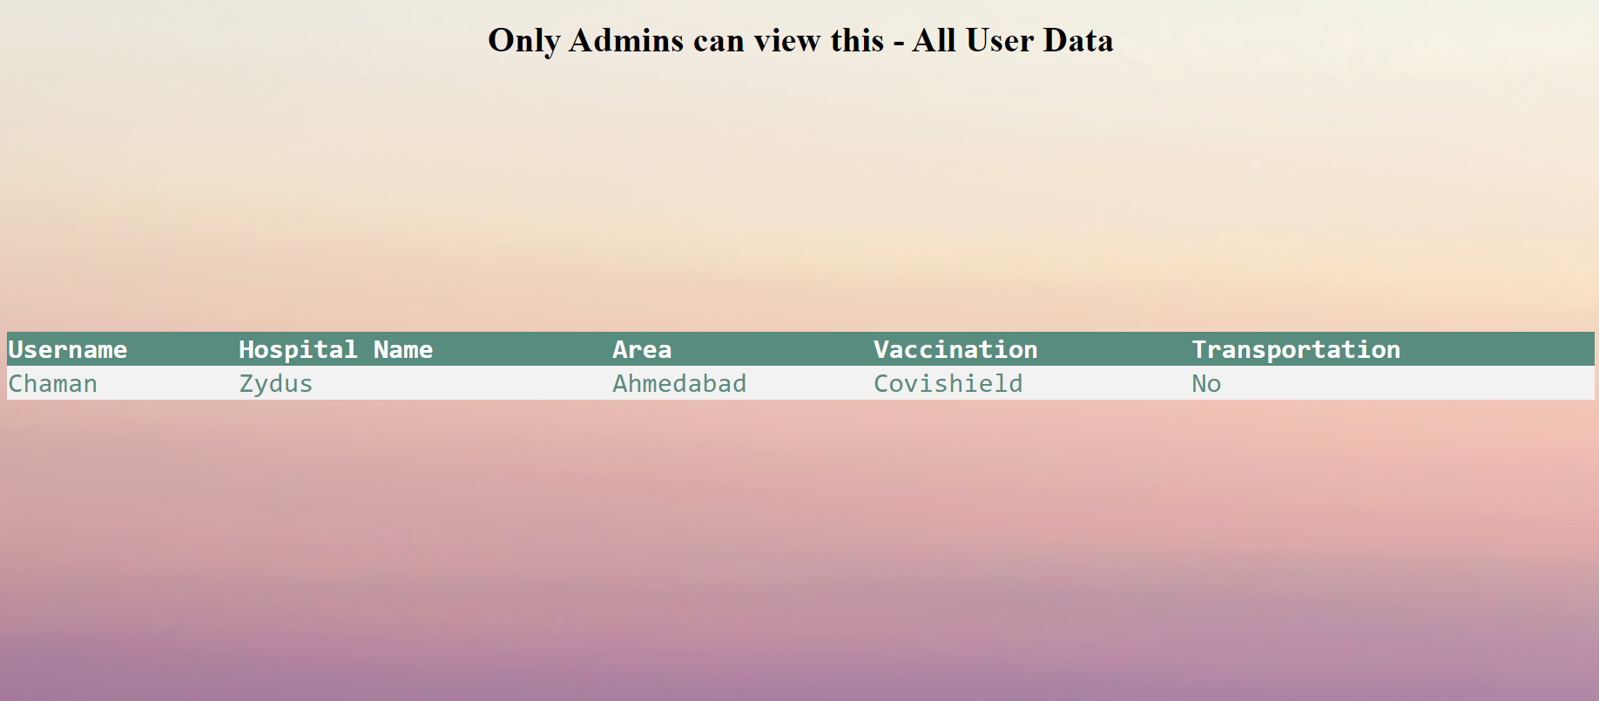
Admin Page

Slide 10
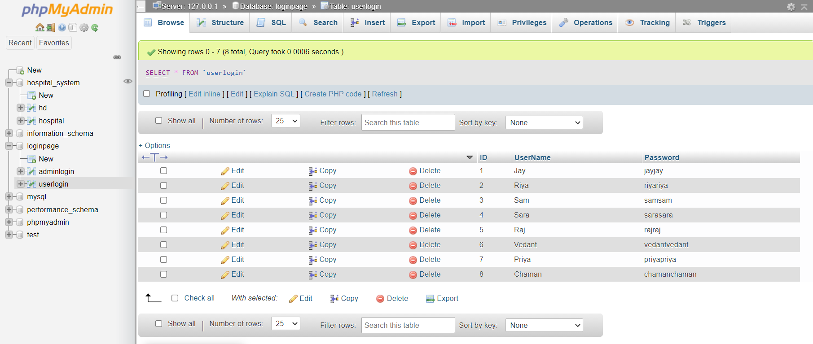
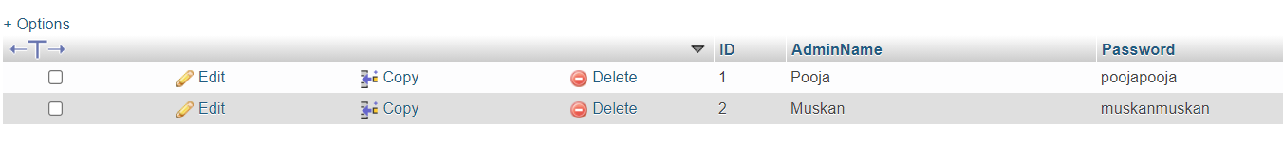
All the Tables Included in the Xampp Server
User Login
Admin login

Slide 11
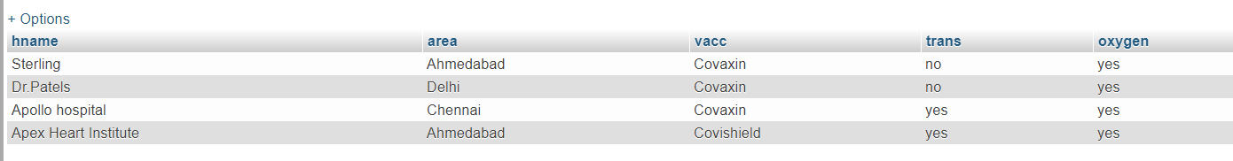
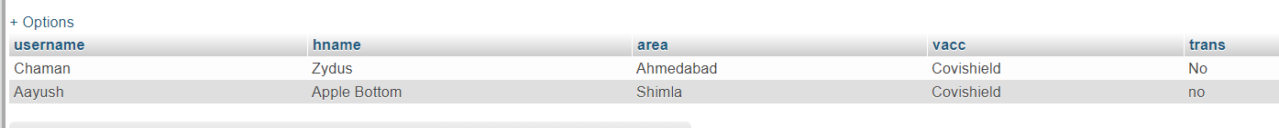
Hospitals Available Table
User Bookings

Slide 12
Wrap-Up
This project as a whole can be used to keep a check on various hospitals, and to book a hospital depending on the various factors available.
This project has scope to improve in the future :-
Filter out Hospitals Area-wise based on the area most convenient to the user.
Be able to provide live statistics of the situation outside. Ex graphs, charts.
We can get in touch with doctors to add a self test page to determine if one is at the risk of getting corona or not, etc.

